Slide 1


Slide 2

Session 2. Introduction to data processing
[90 min]

Slide 3
Session 2. Introduction to data processing
Control structures
[90 min]
[30 min]

Slide 4

Data Science. For economics and policy Controlling your machine. DEC, 15th September 2023

Slide 5
Control structures.

Slide 6
The idea.
Control structures | Flow control | Control statements
We want our programs/analysis to take decisions for us. Not to continue doing the same thing again and again, but to be able to decide what to do next.
Without control structures (AKA ‘flow control’) programs don’t do much.
What might you want a program to do for you?
Stop or start.
Take a decision on what to do next. Do different things in different conditions:
Time of day, or days of the week;
If data has certain properties: (stock market alert).
Do something many times.
Dynamic programming / maximisation;
Batches of analysis: downloading, cleaning, charting.

Slide 7
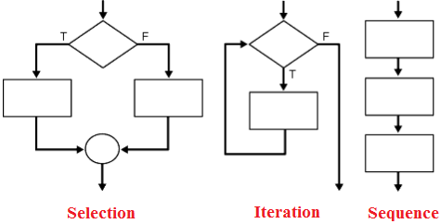
The big three.
Sequence | Iteration | Conditionality/Selection
Programming languages typically feature three types of control:
Sequence. Tells the program the order to do things in.
Selection/conditionality. Makes a decision based on a testable condition.
Iteration. Repeats a command over and over again, until a condition is met. Then stop and continue the code.

Slide 8
Control in data science.
If-else | Loops
In practical terms during a career in data you are going to make daily use two particular examples of these general ideas.
If-else. Test some condition in your data. Based on the results of this test, take a number of different actions.
Loops. Do the same thing to many pieces of data, many variables, many data sets. Or do the same thing on a number of different days.
These can be combined all possible ways.
An if statement inside an if (AKA “nested”)
A loop withing a loop.
If inside a loop
Loop inside an if.

Slide 9





How many languages?
Five?

Slide 10
How many languages?
Three?

Slide 11

Conditionals.

Slide 12

Code as a tree | Conditional statements influence which branch your code goes along.

Slide 13
If-else.
Excel | STATA | Python | JavaScript | CSS
Syntax:
IF({CONDITION}, {VALUE IF TRUE}, {VALUE IF FALSE})
Example:
=if(A1=“Richard”, “Yes”, “No”)

Slide 14
If-else.
Excel | STATA | Python | JavaScript | CSS
Practical usage:
Data cleaning
You have two data sets on countries that you want to match.
But the names are not consistent.
You want to create a column that provides a 1:1 correspondence between the data sets
=if(A1=“Côte d'Ivoire”, “Ivory Coast”, A1)
Categorisation
You have data on firm size, measured by number of employees…
You want to analyse based on two types, large firms and SMEs..
You define SME as anything with up to 250 employees..
=if(A1>250, “Large”, “SME”)

Slide 15
= == === ?
If-else – Are things equal?
Excel | STATA | Python | JavaScript | CSS

Slide 16
=, == and ===
Three uses of equals signs: Stata | JS | Python
=
Assigns value | i.e. it makes the thing on the left equal the thing on the right.
==
Tests value | It checks whether the thing on the left is equal to the thing on the right.
===
Tests value and type | As above, but checks variable type too.

Slide 17
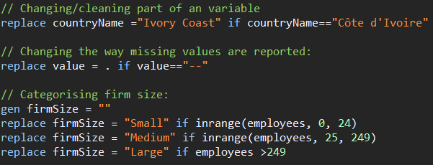
If-else.
Excel | STATA | Python | JavaScript | CSS

Slide 18
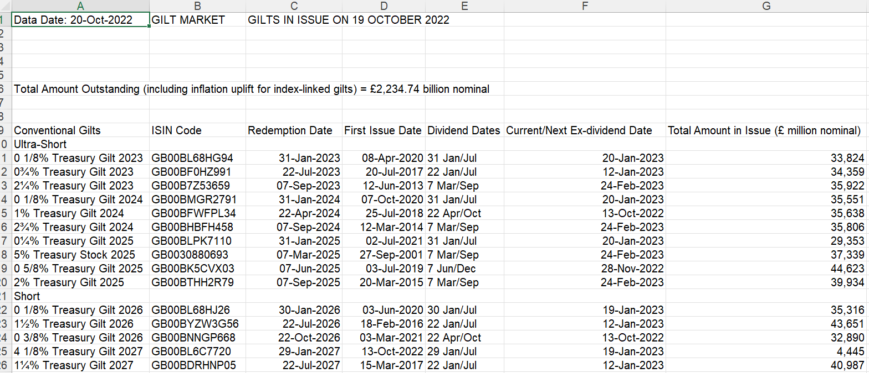
Example. UK Gilt Market
Excel | STATA | Python | JavaScript | CSS
https://dmo.gov.uk/data/gilt-market/gilts-in-issue/

Slide 19

Example. UK Gilt Market
Excel | STATA | Python | JavaScript | CSS
https://github.com/RDeconomist/RDeconomist.github.io/blob/main/data/GiltsInIssueRaw.csv

Slide 20
Example. UK Gilt Market
Excel | STATA | Python | JavaScript | CSS
Advanced example, a STATA do file with lots of if statements helping in the cleaning:
https://github.com/RDeconomist/RDeconomist.github.io/blob/main/data/giltsCleaningData.do
String functions to discuss:
Upper, lower
Split:
At a fixed position.
At a character.
Concatenate
Measuring:
Find the Length
Find the position of a character
Substring
Trim

Slide 21
If-else.
Excel | STATA | Python | JavaScript | CSS
# Simple if:
if CONDITION:
#Code to run if true
#Can be more than one line
# If else:
if CONDITION:
# Code to run if true
else
# Code to run if condition is FALSE
# Elif
if CONDITION_A:
# Code to run if conditionA TRUE.
elif CONDITION_B:
# Code to run if conditionB TRUE.
else:
# Code to run if BOTH conditions are FALSE.

Slide 22
If-else.
Excel | STATA | Python | JavaScript | CSS
# Example: how big are firms in our dataset?
firm1 = 14
firm2 = 250
# Comparing values
if firm1 > firm2:
print("Firm 1 has more employees than Firm 2")
else:
print("Firm 2 has more employees than Firm 1")
# Assessing size
if firm1 > 249:
print("Firm 1 is large")
else:
print("Firm 1 is an SME")

Slide 23
If-else.
Excel | STATA | Python | JavaScript | CSS
//Simple if condition
if (condition) {
// Add code here--can be many lines, to run if the condition is TRUE.
// If the condition is FALSE then nothing happens
}
//If else
if (condition) {
// Code to run if condition TRUE.
} else {
// Code to run if condition FALSE.
}
//If-elif-else:
if (conditionA) {
// Code to run if conditionA TRUE.
} else if (conditionB) {
// Code to run if conditionB TRUE.
} else {
// Code to run if BOTH conditionA and conditionB are FALSE.
}

Slide 24
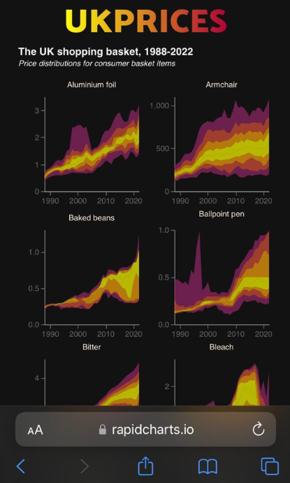
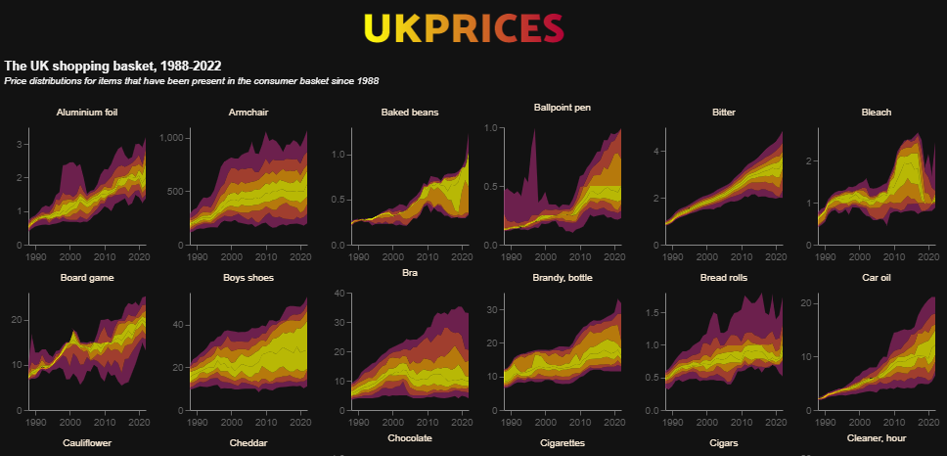
Example: screen sizes
Excel | STATA | Python | JavaScript | CSS
https://rapidcharts.io/prices
Phone
Desktop

Slide 25
Example: screen sizes
Excel | STATA | Python | JavaScript | CSS
<!-- CONDITIONAL SCRIPT TO EMBED BASED ON SCREEN WIDTH -->
<script>
// Find the current screen width:
let width = screen.width;
// Use an if function to pick the approprite visualisation:
if (width > 950) {
prices1 = "charts/ONSinflation/distributionsPerrenials_DarkWide.json";
} else if (width > 450) {
prices1 = "charts/ONSinflation/distributionsPerrenials_DarkMedium.json";
} else {
prices1 = "charts/ONSinflation/distributionsPerrenials_DarkNarrow.json";
}
// Now embed the chart, which will vary based on screen width:
vegaEmbed('#chart1', prices1, {"actions": false});
</script>
<!-- END - CONDITIONAL SCRIPT TO EMBED BASED ON SCREEN WIDTH -->

Slide 26
If-else.
Excel | STATA | Python | JavaScript | CSS
CSS does not officially support conditionals.
But there is a way we can make CSS react in different ways in different situations?
Media Queries (@media) allow you to change the look based on screen size:
With these you are saying:
If the screen size is {CONDITION} then do this {ACTION}
So CSS does allow conditionals.
Understanding this is the way to make your site have two looks: one for mobile, one for laptop/desktop.

Slide 27
If-else.
Excel | STATA | Python | JavaScript | CSS
/* Some CSS to alter the colour of my site */
body{
background-color: white;
}
/* Screen size 1 */
@media screen and (max-width: 450px) {
body {
background-color: lightblue;
}
}
/* Screen size 2 */
@media screen and (max-width: 600px) {
body {
background-color: blue;
}
}
/* Screen size 3 */
@media screen and (max-width: 800px) {
body {
background-color: pink;
}
}
What colour on:
Smartphone?
Laptop?
iPad?

Slide 28
If-else.
Excel | STATA | Python | JavaScript | CSS
/* Some CSS to alter the colour of my site */
body{
background-color: white;
}
/* Screen size 1 */
@media screen and (max-width: 450px) {
body {
background-color: lightblue;
}
}
/* Screen size 2 */
@media screen and (max-width: 600px) {
body {
background-color: blue;
}
}
/* Screen size 3 */
@media screen and (max-width: 800px) {
body {
background-color: pink;
}
}
What colour on:
Smartphone? (400px wide)
Laptop? (~1350px)
iPad? (768x1024)

Slide 29
Loops.

Slide 31
Loops.
Excel | STATA | Python | JavaScript | CSS
The Excel GUI is not built for iteration.
You can write loops in its background language VBA
This is fiddly

Slide 32
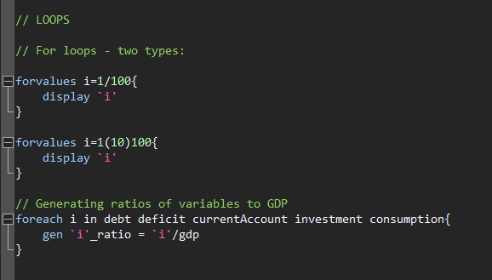
Loops.
Excel | STATA | Python | JavaScript | CSS

Slide 33
Loops.
Excel | STATA | Python | JavaScript | CSS
for i in range (1, 100):
print i
for i in range (1, 10, 100):
print i
for i in range (1, 100, 10):
print i
variables = ["debt", "deficit", "GDP", "inflation"]
for i in variables:
print(i)
An example of subtle differences between languages / functions.

Slide 34
Loops.
Excel | STATA | Python | JavaScript | CSS
for (statement_1; statement_2; statement_3) {
// Code block to run
}
What happens here:
Statement_1 runs once, before the code block starts.
Statament_2 defines a condition that must hold for the code block to run.
Statement_3 runs each time the code block has been executed.

Slide 35
Loops.
Excel | STATA | Python | JavaScript | CSS
for (let i = 1; i < 101; i++) {
console.log(i);
}
for (let i = 1; i < 101; i+10) {
console.log(i);
}

Slide 36
Loops.
Excel | STATA | Python | JavaScript | CSS
// Set a list of variables:
variables = ["debt", "deficit", "GDP", "inflation"]
// We can index these:
console.log(variables)
console.log(variables[0])
console.log(variables[3])
// Work out how long this thing is:
len = variables.length
// Iterate though it, printing out each particular variable
for (let i=0; i<len; i++) {
x = variables[i]
console.log(x)
}
Example in this week’s DropBox folder

Slide 37
Loops.
Excel | STATA | Python | JavaScript | CSS
Again CSS is not really built for looping
However, it can repeat commands. An example: @keyframes (an At-Rule).
One example is the @keyframes
@keyframes border-pulsate2 {
0% { border-color: #22e68b}
10% { border-color: rgba(230, 34, 75, 0)}
20% { border-color: rgba(230, 34, 75)}
30% { border-color: rgba(230, 34, 75, 0)}
40% { border-color: rgba(0, 47, 167)}
50% { border-color: rgba(230, 34, 75, 0)}
60% { border-color: rgba(250, 250, 0)}
70% { border-color: rgba(230, 34, 75, 0)}
80% { border-color: #22e68b}
}
.readingWeek {
background-color: #122b39;
border-radius: 10px;
border-style: dotted;
border-width: 5px;
height:100%;
animation: border-pulsate2 2s infinite;
}
Notes:
RS: insert example of a terrible chart

Slide 38
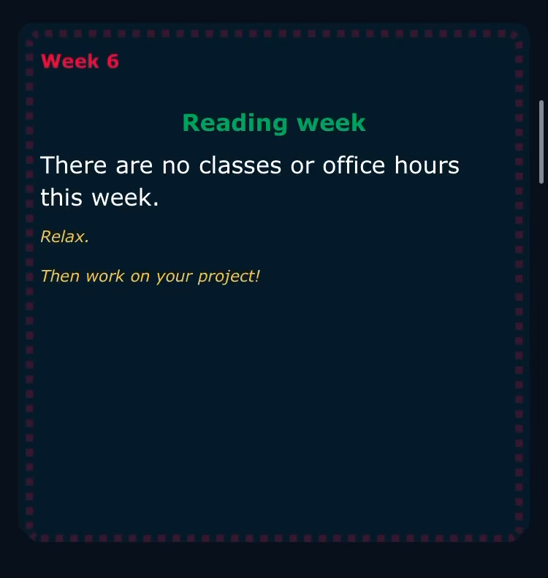
Loops.
Excel | STATA | Python | JavaScript | CSS
Again CSS is not built for looping
However, it can iterate over certain commands for a given time. One example
@keyframes border-pulsate2 {
0% { border-color: #22e68b}
10% { border-color: rgba(230, 34, 75, 0)}
20% { border-color: rgba(230, 34, 75)}
30% { border-color: rgba(230, 34, 75, 0)}
40% { border-color: rgba(0, 47, 167)}
50% { border-color: rgba(230, 34, 75, 0)}
60% { border-color: rgba(250, 250, 0)}
70% { border-color: rgba(230, 34, 75, 0)}
80% { border-color: #22e68b}
}
.readingWeek {
background-color: #122b39;
border-radius: 10px;
border-style: dotted;
border-width: 5px;
height:100%;
animation: border-pulsate2 2s infinite;
}

Slide 39
Using loops
Notes:
RS: insert example of a terrible chart

Slide 40
Using loops.
Batching analysis
Problem: We often have too much data
How can visualising help us understand the data in the early stage of a project?
Code intuition:
Think of a chart that summarises the data in some useful way:
[Useful options: histogram, percentiles as a swathe.]
Code this chart for one part (one firm, one year, one product).
Use a loop: for each product, draw the chart
Example: UK CPI data, which has ~1300 products.
Notes:
RS: insert example of a terrible chart

Slide 41
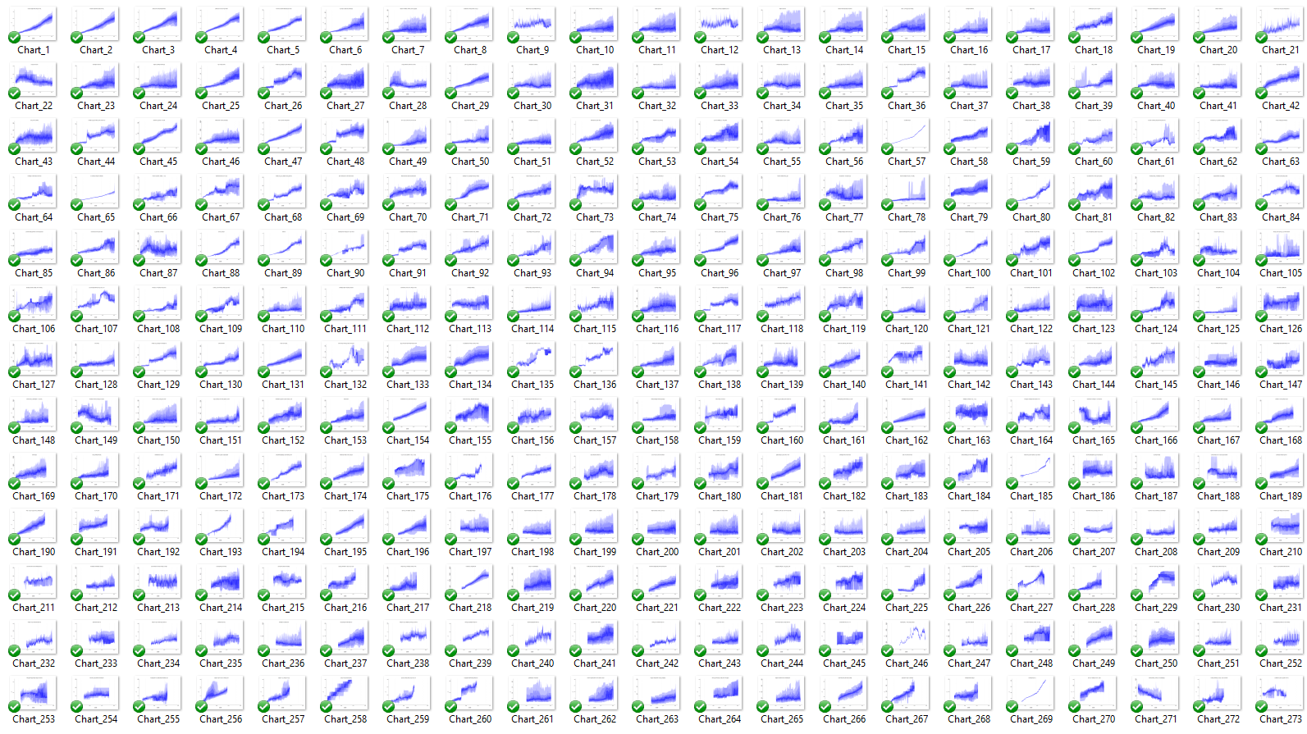
Notes:
RS: insert example of a terrible chart

Slide 42
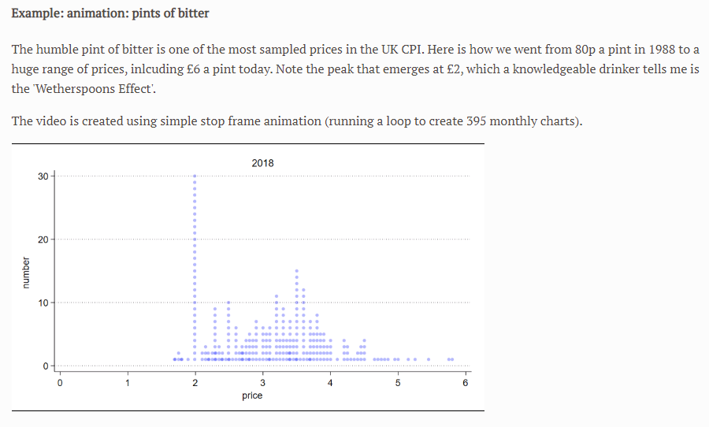
Using loops.
Stop frame animation
Watch the video here:
https://richarddavies.io/research/prices
[Scroll to the bottom]
Code intuition:
For dates i, draw histogram if date==i. Save chart as png.
Notes:
RS: insert example of a terrible chart

Slide 43


Using loops.
For fun: exploding bubbles
https://rapidcharts.io/index_old
Code intuition:
For n bubbles, pick a size, x direction and y direction. Use random numbers so different each time.
Notes:
RS: insert example of a terrible chart

Slide 44
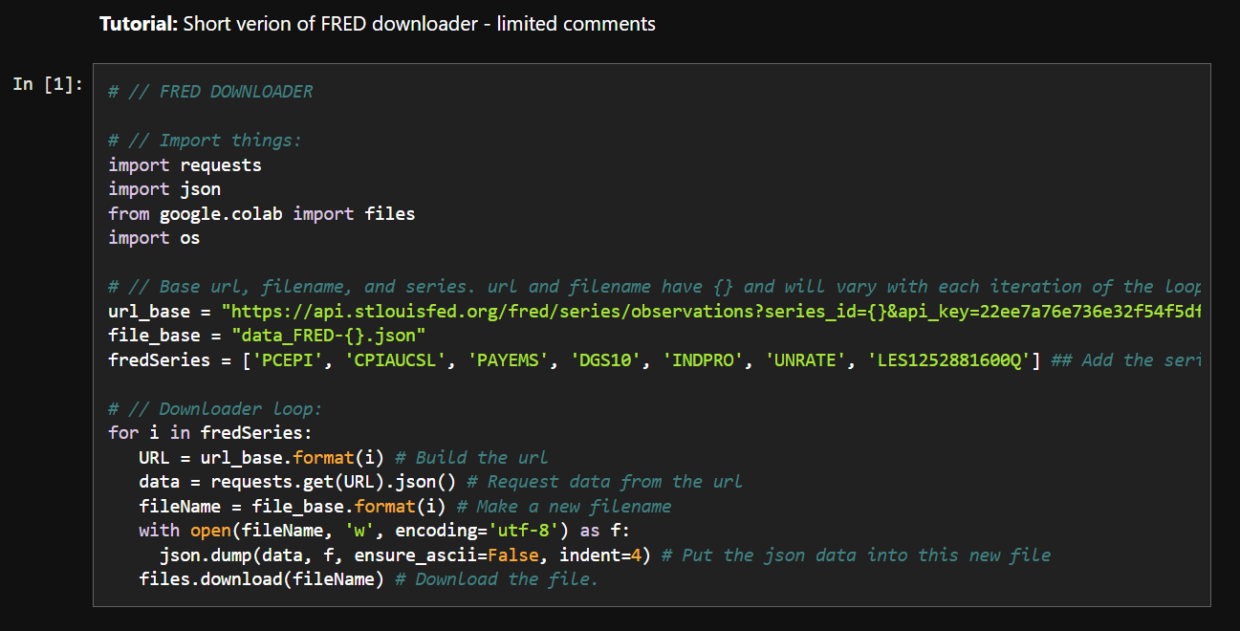
Using loops.
Aim for our code along – to understand the following (and why it is so helpful)

Slide 45
Using loops.
Links to code
First examples of loops:
https://github.com/RDeconomist/RDeconomist.github.io/blob/main/data/DSEP_2_0_loopsExamples.ipynb
FRED data downloader, step by step:
https://github.com/RDeconomist/RDeconomist.github.io/blob/main/data/DSEP_2_1_LoopsFREDdownloader.ipynb
FRED data downloader, essential steps only:
https://github.com/RDeconomist/RDeconomist.github.io/blob/main/data/DSEP_2_2_loopsFREDshort.ipynb
Discussion of ONS API:
https://github.com/RDeconomist/RDeconomist.github.io/blob/main/data/DSEP_2_3_loopsONS.ipynb

Slide 46
Option 1. Direct link to API
Pros
Auto-updating
No data errors
Cons
Slow/lags
Multiple downloads: may be costly if a paid API.
If API is unstable, your analysis becomes unstable.
Source
Your site
Notes:
RS: insert example of a terrible chart

Slide 47
Option 2. Link to live CSV file
Pros
Fast
Stable
APIs don’t always exist: may be your only option.
Cons
Won’t auto-update
Requires maintenance
Source
GitHub/Server
Your site
Notes:
RS: insert example of a terrible chart

Slide 48
Session 2. Introduction to data processing
Code-along
[90 min]
[30 min]
Notes:
A demo of ONS API in the browser
A demo of the ECO API in the browser (and explain how our URL is easier to look at)
Show them the ECO Data Hub – Data Explorer / Chart Builder
Import they finished API-linked chart from the Chart Builder and embed it

Slide 49
ECO API
api.econ.ac/gbr/unem
api.econ.ac/usa/unem
econ.ac/data-hub
Notes:
Diff between
https://api.econ.ac/gbr/unem
https://api.econ.ac/gbr/unem?vega

Slide 50
start in the ECO Data Hub
then customize in Vega-Lite

